Slide 1
08.10.2022
Class 3

Slide 2
2.Comparison of leaders of Past & Present

Slide 3
Comparison of leaders of Past & Present
 | Past | Present
1 | Reasonably stable world | Past is an old concept, future is unimaginable while present exists for a nano-second
2 | Moderate customer expectations | Customers with great expectations
3 | More loyal | Less certainty
4 | More of administering and directing | Guiding & inspiring
5 | Less amount of continuous learning | More of continuous learning in an everchanging world
6 | Not open to receive critics | Open to correct themselves with broader perspectives
7 | Faced Less problem solving environment | Facing more problem solving situations
8 | Moderate self awareness is enough | More self awareness is needed which helps in designing new aspects of growth
9 | Moderate communication is enough as there exists a defined system | Improved communication is essential to keep up with evolving changes
10 | Think locally | Think globally

Slide 4
3. Society’s interests versus Self-interests

Slide 5
What is Social interest?
Meaning of Social Interest
This term refers to the individual's awareness of belonging in the human community and the extent of his or her sense of being a fellow being.
Social interest is a capacity inherent in all human beings which must be developed and trained, analogous, in this way, to the capacity for language and speech
Examples:
Volunteering (with no recognition or monetary compensation)
Teaching or sharing ideas.
Investing in savings bonds (helping the government fund schools)

Slide 6
Meaning of Self Interest?
Self-interest generally refers to a focus on the needs or desires of one's self.
Most times, actions that display self-interest are often performed without conscious knowing.
Self-interest refers to actions that elicit personal benefit.
Examples:
Gaining a good degree
Joining a inspiring company
Owning a house, car and farmlands

Slide 7
Conflict of interest
Conflict of interest (COI) is
a situation in which a person or organization is involved in multiple interests, financial or otherwise, and serving one interest could involve working against another.
Typically, this relates to situations in which the personal interest of an individual or organization might adversely affect a duty owed to make decisions for the benefit of a third party.
A conflict of interest is a set of conditions in which professional judgment concerning a primary interest (such as a patient's welfare or the validity of research) tends to be unduly influenced by a secondary interest (such as financial gain).
Conflict-of-interest rules, regulate the disclosure and avoidance of these conditions.
— Dennis F. Thompson, The New England Journal of Medicine, 1993

Slide 8
Conflict of interest
A widely used definition is: "A conflict of interest is a set of circumstances that creates a risk that professional judgement or actions regarding a primary interest will be unduly influenced by a secondary interest.“
Primary interest refers to the principal goals of the profession or activity, such as the protection of clients, the health of patients, the integrity of research, and the duties of public officer.
Secondary interest includes personal benefit and is not limited to only financial gain but also such motives as the desire for professional advancement, or the wish to do favours for family and friends.

Slide 9
These secondary interests are not treated as wrong in and of themselves, but become objectionable when they are believed to have greater weight than the primary interests.
Conflict of interest rules in the public sphere mainly focus on financial relationships since they are relatively more objective, fungible, and quantifiable, and usually involve the political, legal, and medical fields.

Slide 10
Linking self-interest and social-interest
Eg:1 Environmental hazards and human health
Baker summarized 176 studies of the potential impact of Bisphenol A on human health as follows:
Funding Harm No Harm
Industry 0 13 (100%)
Independent (e.g., government) 152 (86%) 11 (14%)
Linking self-interest and social-interest

Slide 11
Lessig noted that this does not mean that the funding source influenced the results
However, it does raise questions about the validity of the industry-funded studies specifically, because the researchers conducting those studies have a conflict of interest; they are subject at minimum to a natural human inclination to please the people who paid for their work.
Lessig provided a similar summary of 326 studies of the potential harm from cell phone usage with results that were similar but not as stark

Slide 12
Linking self-interest and social-interest
Eg:2 LIMITATIONS OF MARKETS
Competitive markets can provide incentives that work against discrimination.
However, markets have sometimes contributed to discrimination:
American professional baseball was once characterized by rigid racial segregation. Some owners hired only white players because of long-standing racial prejudice. Other owners feared fans would react negatively at the box office if they hired nonwhite players, so discrimination existed for economic reasons.
Nonmarket factors also influence people’s behavior: Some business owners may value their social status more than profits. These owners might condone racial or gender discrimination even if discrimination reduces their profits.

Slide 13
Moral norms and values are influenced by many institutions:
competitive markets
families
religions
schools
voluntary organizations

Slide 14
4. Personal Social Responsibility: Helping the needy, charity and serving the society

Slide 15
Meaning of Personal Social Responsibility
What is Personal Social Responsibility (PSR): is the primary responsibility of every individual toward family, workplace, community, and environment (both ecological and social).
In order to understand PSR, first let’s understand what is social responsibility and how it is interlinked with three different components.
Social responsibility is an ethical framework which suggests that an entity, be it an organization or individual, has an obligation to act for the benefit of society at large

Slide 16
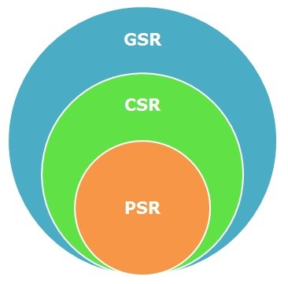
What constitutes social responsibility?
Social responsibility has 3 components which ideally should be closely interlinked to maximize the impact. They are:
Government Social Responsibility (GSR): The basic duty of a government involves the big social welfare programs through which it creates the best environment for its people
Corporate social responsibility (CSR), is a form of corporate self-regulation integrated into a business model. According to Business Dictionary, CSR is: A company's sense of responsibility towards the community and environment (both ecological and social) in which it operates.
Personal Social Responsibility (PSR) - is the primary responsibility of every individual towards family, workplace, community, and environment (both ecological and social).

Slide 17
So what is PSR?
It is the moral responsibility of every citizen to do the right thing
It is voluntary and about personal integrity, ethics, commitment and ownership
It is about give and take and striving towards continuous betterment of society
What it is not?
It is not about charity or volunteering or taking up causes.
It is not about some giving all the time and others receiving all the time
It is not a one way process or a one-time activity

Slide 18
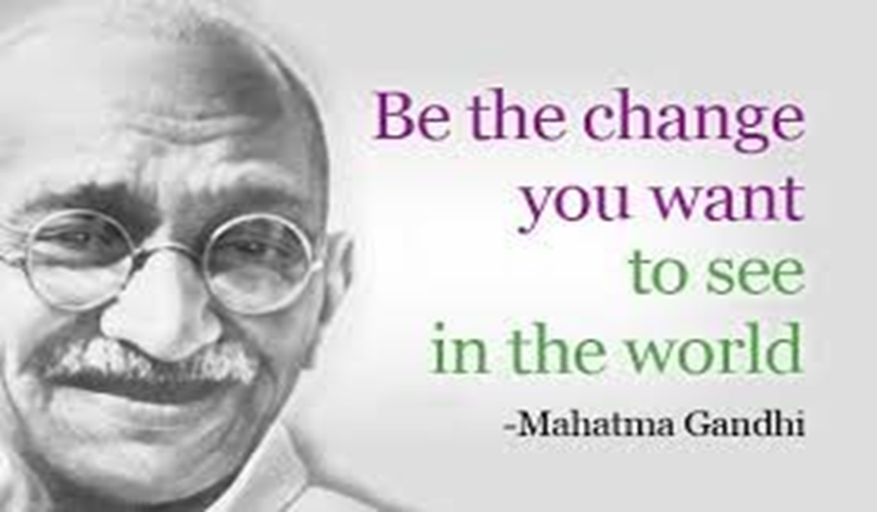
So who has the onus of social responsibility?
Historically it has been Government and more recently corporates along with philanthropists and other like-minded people.
However, social responsibility is not only about a series of programs run by the Government for the welfare of the people or corporate or other non-governmental programs.
Social responsibility is not the vested duty of chosen few, but is and should be the responsibility of every citizen- Which is what is called as PERSONAL SOCIAL RESPONSIBILITY

Slide 19
How PSR works?
1.Helping the needy
Meaning of Needy
lacking the necessities (food, cloth & shelter) of life; very poor.
2. What is charity
generosity and helpfulness especially toward the needy or suffering
3. Types of Non Profit Organizations in India
The law which governs Societies in India is the Society Registration Act of 1960.
7 or more people are required to form an NGO as a Society.
The purpose they come together for should be a common purpose and can be a scientific purpose, a charitable purpose or a literary purpose.

Slide 20
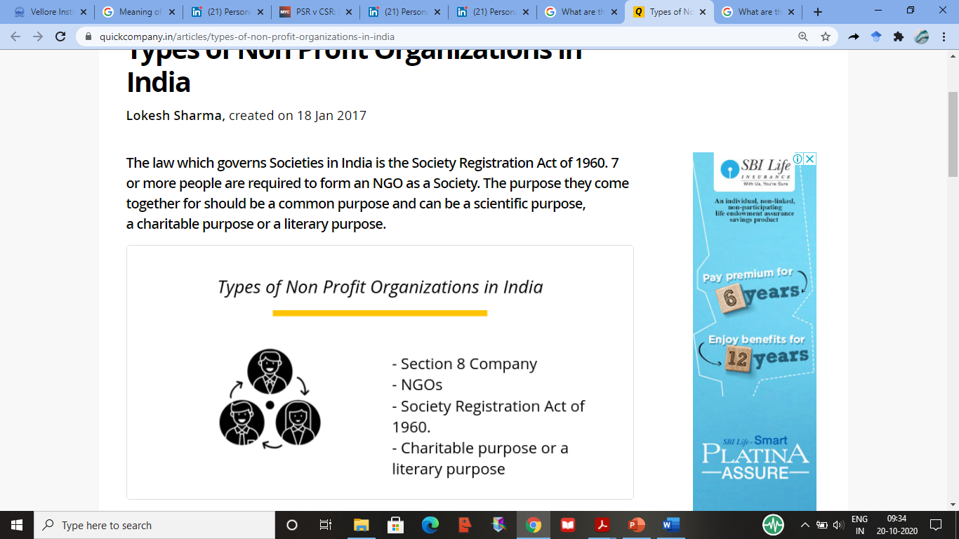

Slide 21
Types of non-profit organizations in India
Section 8 companies
NGO’s
companies can be established for the promotion of commerce, arts, science, sports, education, research, social welfare, religion, charity, and protection of environment or any such other object.
As per the act, the profit of such companies can be used only to promote the objectives of the company and nothing in the form of dividends is payable to any of its members
Non-Government Organization or NGOs, comes under Section 8 of the Companies Act.
Registrations for NGOs are mandatory in India and are allowed to receive foreign funds.
However, the funds received under NGOs are monitored and referred further to a recommendation from the National Intelligence Agency to The Prime Minister of India

Slide 22
Additional Reading
https://www.linkedin.com/pulse/personal-social-responsibility-psr-jayashree-venugopala/
https://www.mycustomer.com/selling/sales-performance/psr-v-csr-is-personal-social-responsibility-still-good-for-business

